Slide 1

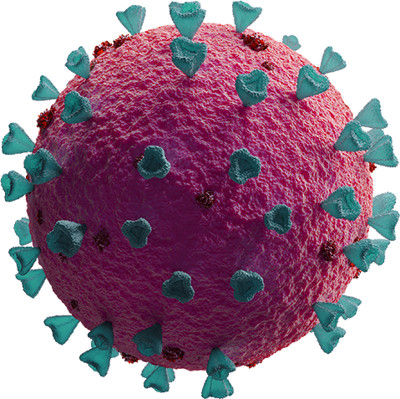
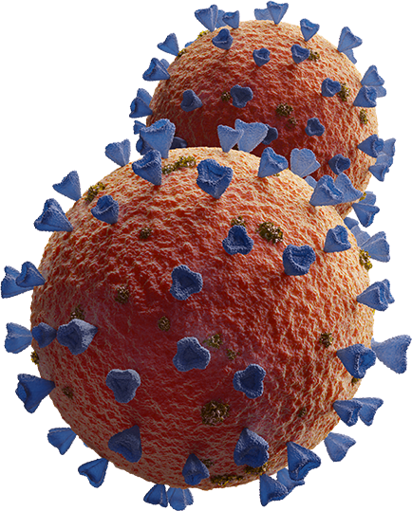
Making Sense of Mismatch between Predicted and Actual OMICRON Infections in BC
Piyush Agarwal

Slide 2

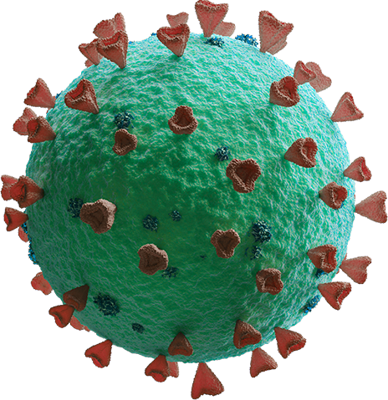
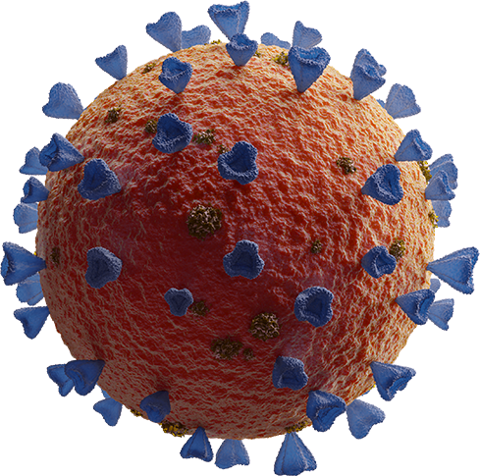
TABLE OF CONTENTS
01
02
03
04
05
PROBLEM SOURCE & DATA
EPIDEMIC MODEL
MODEL FITTING
RESULTS
CONCLUSION

Slide 3
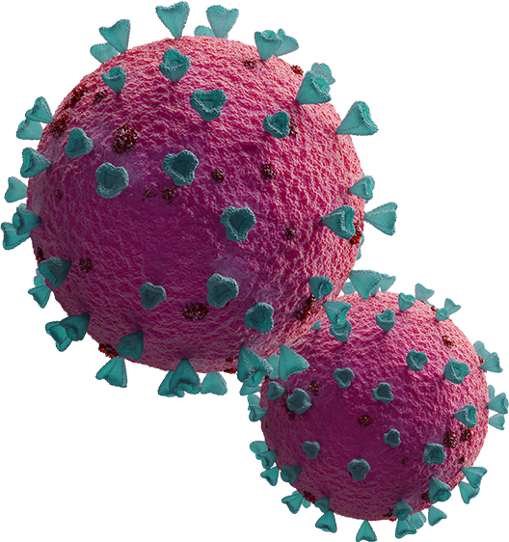
QUESTION TACKLED
In British Columbia, the predicted number of COVID-19 infecteds during the Omicron wave was much higher than the actual numbers. Can we make sense of it in retrospect?

Slide 4
OMICRON WAVE IN BC
DECEMBER, 2021
JANUARY, 2022
FEBRUARY, 2022
From BC COVID-19 Modelling Group

Slide 5
EARLY DECEMBER, 2021
Variant of Concern; First few cases in Canada
BC Covid-19 Modelling Group trying to answer:
Rate of Spread
Degree of Severity
Difficult to answer, with little information regarding
Transmission among vaccinated people
Risk of deaths and critical illnesses

Slide 6
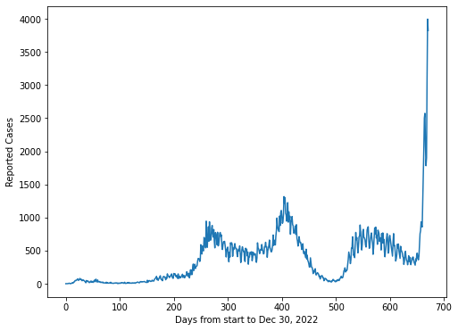
LATE DECEMBER, 2021
“Omicron is now established and spreading within BC”
Doubling Time of Infections: 3 days
Demand on healthcare to be extreme in January

Slide 7
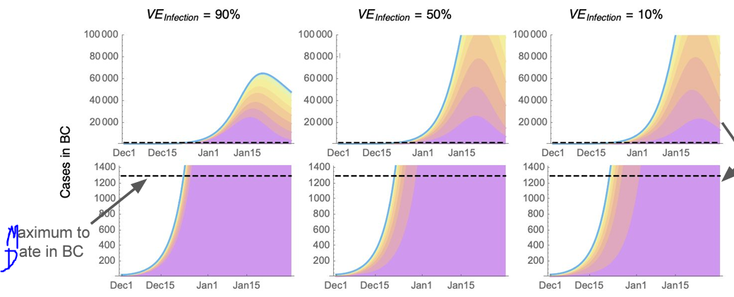
LATE DECEMBER, 2021: PROJECTED NUMBERS
Fig: Projected Omicron Cases in BC
Img. source: Dr. Sally Otto’s CoVaRR-Net Pillar 6

Slide 8
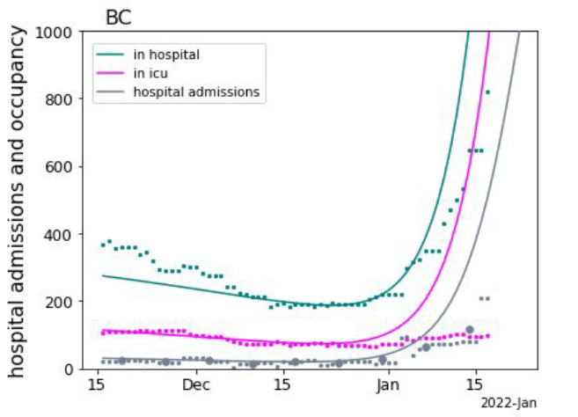
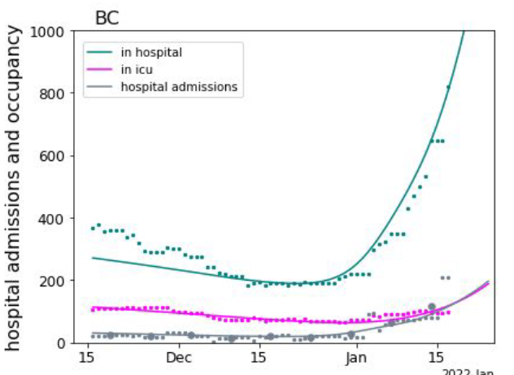
MID-JANUARY, 2022
Testing Capacities breached in BC, general case data no more useful, rely on hospital data
Evidence that omicron transmission rate has declined, (slow growth in hospital admissions)
At this point, omicron growth rate slashed to half to match actual hospital intake values.
Predicted that infections would peak in late January/ early February
Growth rate: 20%
Growth rate: 10%

Slide 9
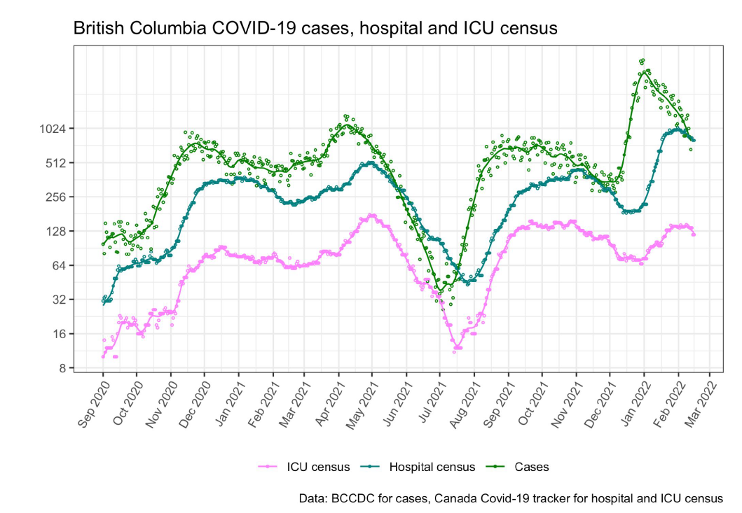
FEBRUARY, 2022
Decline in cases in individuals > 70 and hospital admissions due to covid indicated that
many parts in BC got beyond the Omicron peak
BC’s booster program likely to be a major contributing factor in bending the curve

Slide 10
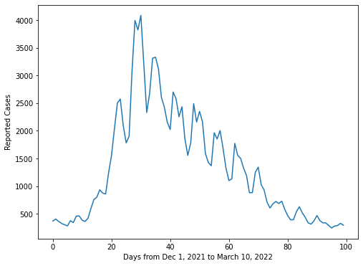
DAILY REPORTED CASE DATA
WE FIT THE MODEL WITH DATA FROM THE FIRST 20 DAYS
Data taken from BCCDC

Slide 11
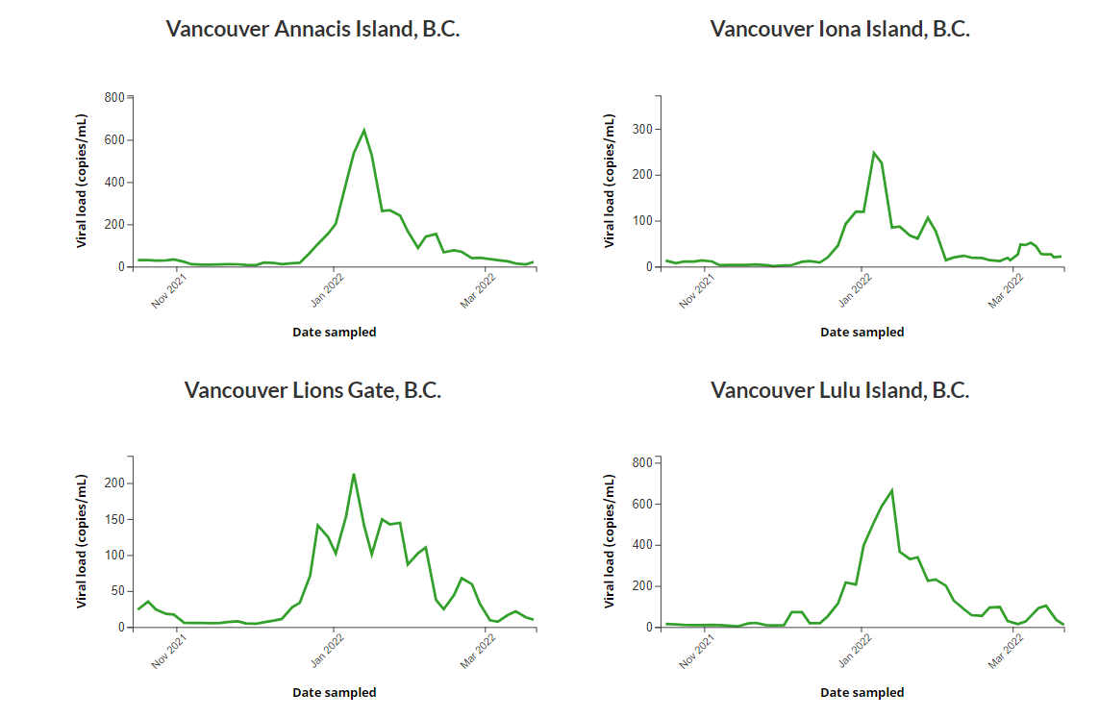
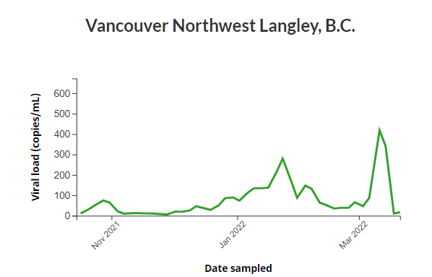
VANCOUVER WASTE WATER DATA
Waste Water Data: Giving relative idea of frequency of Covid infected patients. Raises our confidence in the daily case data.
Data not normalized by flow rate

Slide 12
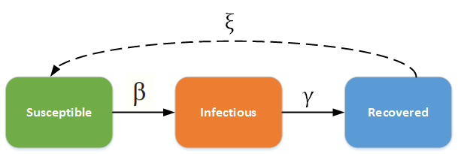
MODELLING
SIRS MODEL

Slide 13
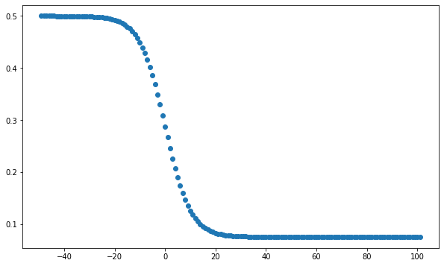
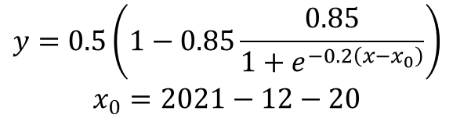
CALIBRATION FOR INFECTIONS NOT TESTED
$$y=0.5\left(1−0.85\frac{0.85}{1+e^{−0.2\left(x−x_{0}\right)}}\right)$$
$$x_{0}=2021−12−20$$

Slide 14
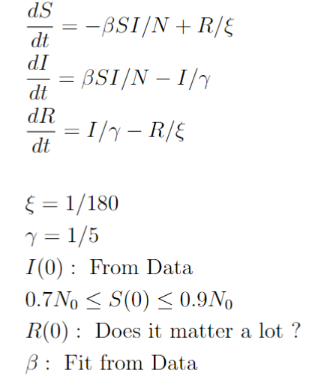
MODEL FITTING

Slide 15
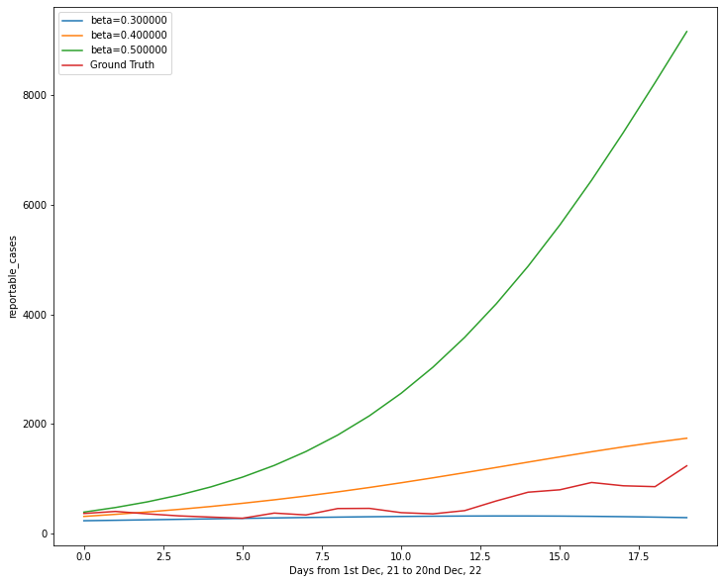
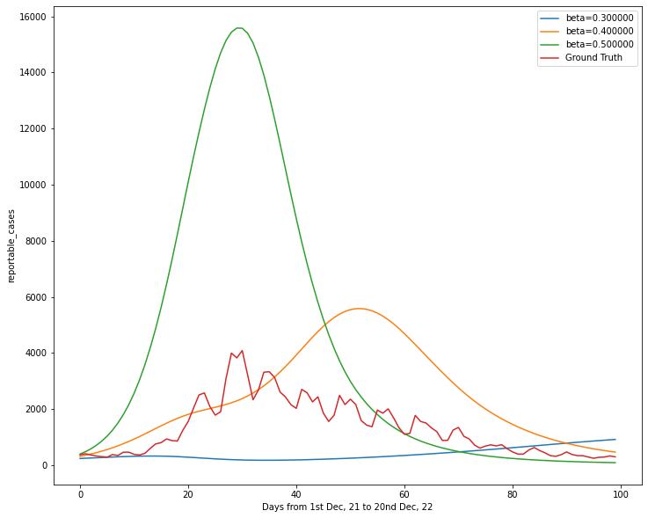
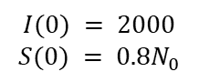
MODEL FITTING
$$I(0) = 2000$$
$$S(0) = 0.8N_{0}$$

Slide 16
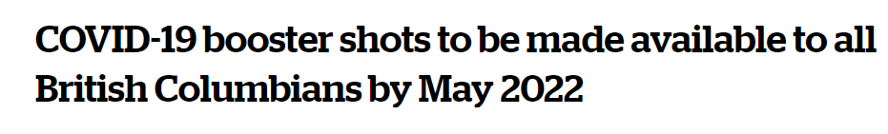
01
VACCINATION
Rapid BC Booster Program
Source: CBC News

Slide 17
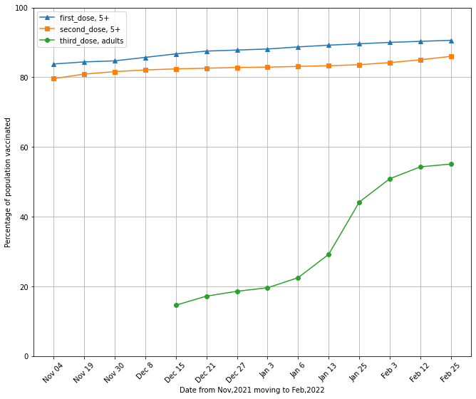
Booster Doses to 2.55 Mil. adults in BC
Data taken from Vancouver Sun, and data for the third dose was not available before Dec 15

Slide 18
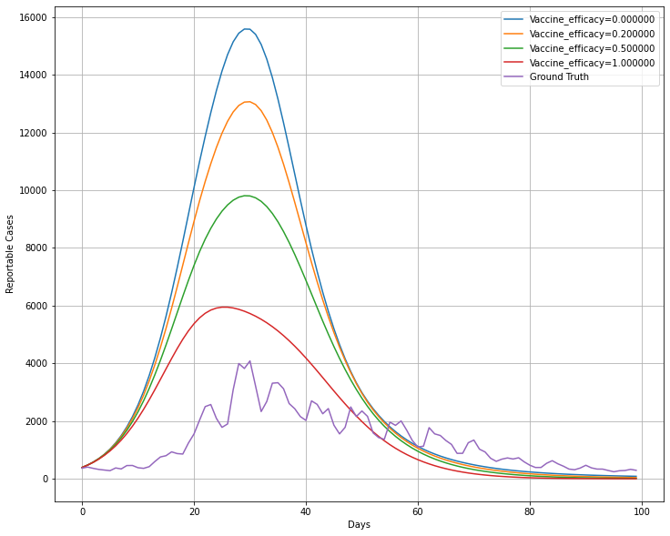
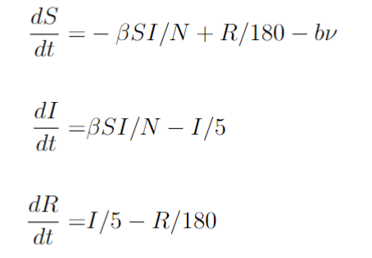
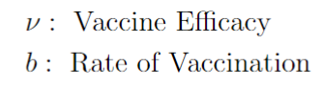
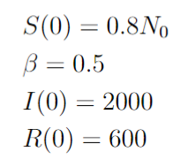
Possible Dynamics of the Epidemic with different vaccine efficacies and No vaccine

Slide 19
02
CASE IMPORTATIONS
As cases from outside were not considered in the model, did this artificially bloat the rate of transmission leading to higher predicted cases?

Slide 20
Total International Travellers in Jan, 2022: 75,692
(includes people from the United States who travelled over-night.
Total International Travellers in Dec, 2021: 155,917
Total International Travellers in Nov, 2021: 95,554

Slide 21
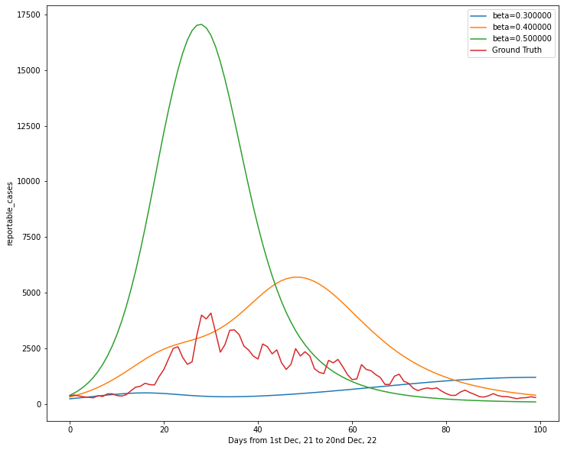
IMPORTATIONS OF CASES

Slide 22
KEY TAKEAWAYS
To Tame a Pandemic, reducing the number of Susceptibles should be a high priority
In small periods of time (few weeks) I think that case importations don’t play a big role

